Slide 1
CSC 374/407: Computer Systems II
Lecture 4
Joseph Phillips
De Paul University
2014 January 3
Copyright © 2011 Joseph Phillips
All rights reserved

Slide 2


Reading
Bryant & O'Hallaron “Computer Systems, 2nd Ed.”
  Chapter 8: Exception Control Flow
Hoover “System Programming”
  System Calls 7.1-7.4

Slide 3
Topics
Signals
setjmp() and longjmp()

Slide 4
Remember the shell . . .
Let's re-write our simple shell program from last time.
We may use:
  fork()
  execl(char* path, char* arg0, char* arg1, . . .)
  wait(int* statusPtr)
  waitpid(pid_t pid, int* statusPtr, int flag)

Slide 5
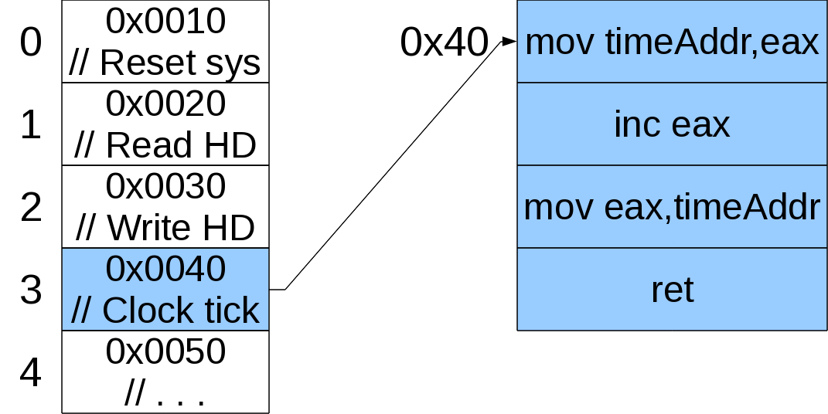
Remember: One interrupt vector table for whole computer

Slide 6
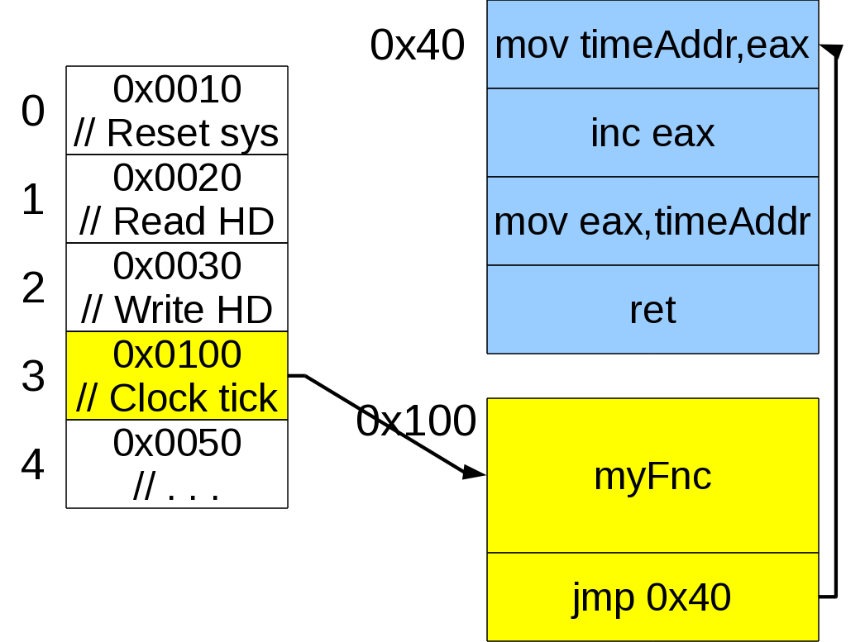
Remember how to do something periodically?

Slide 7
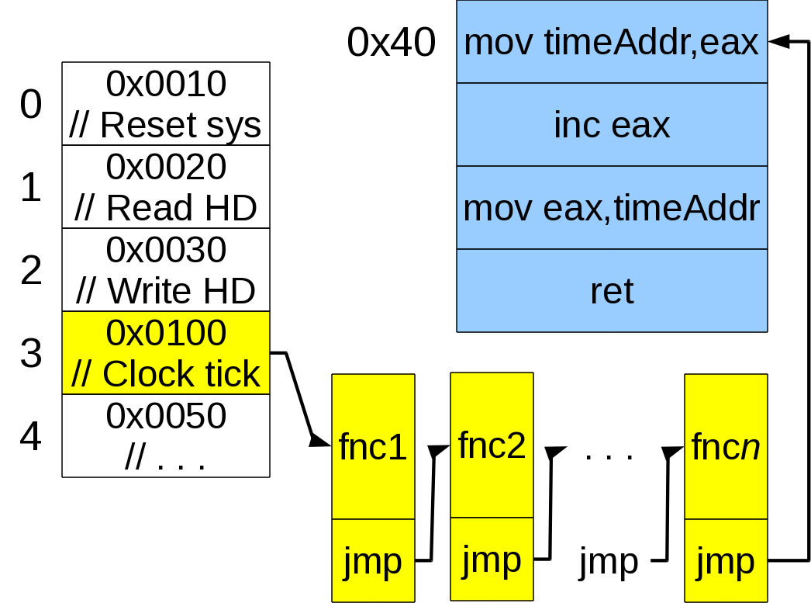
Is this technique efficient when there are many things to schedule?

Slide 8
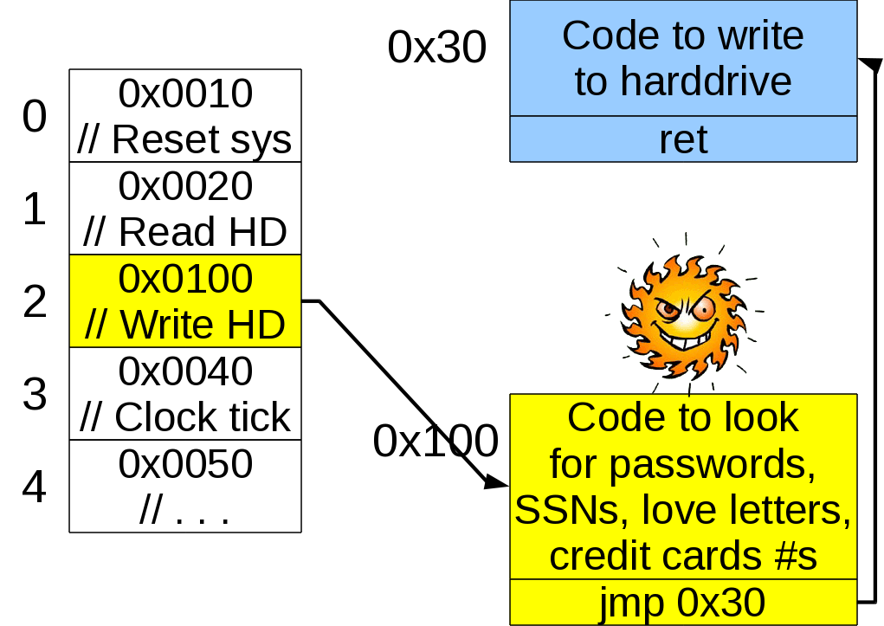
Is this technique secure?

Slide 9
Signals: a better idea
The whole computer still has its interrupt table
  Nobody can mess with it except OS and ROM BIOS
Each process has its own “personal” interrupt table
It's “interrupts” include
  You set the alarm and went to sleep(), now it's Time to wake up!
  Hey! One of your children just finished!
  Close things down and finish, or less politely . . .
  Die now!

Slide 10
List of signals (Linux i386) (1)
The default actions are:
  Term: terminate the process
  Core: terminate the process and dump the core
  Ign: ignore the signal
  Stop: stop the process
Signal Value Action Comment
-------------------------------------
SIGHUP 1 Term Hangup detected on controlling
terminal or death of controlling
process.
SIGINT 2 Term Interrupt from keyboard (Ctrl-C)
SIGQUIT 3 Core Quit from keyboard
SIGILL 4 Core Illegal Instruction
SIGABRT 6 Core Abort signal from abort(3)
SIGFPE 8 Core Floating point exception
SIGKILL 9 Term Kill signal

Slide 11
List of signals (Linux i386) (2)
Signal Value Action Comment
-------------------------------------
SIGSEGV 11 Core Invalid memory reference
SIGPIPE 13 Term Broken pipe: write to pipe with no
readers
SIGALRM 14 Term Timer signal from alarm(2)
SIGTERM 15 Term Termination signal
SIGUSR1 10 Term User-defined signal 1
SIGUSR2 12 Term User-defined signal 2
SIGCHLD 17 Ign Child stopped or terminated
SIGCONT 18 Continue if stopped
SIGSTOP 19 Stop Stop process
SIGTSTP 20 Stop Stop typed at tty
SIGTTIN 21 Stop tty input for background process
SIGTTOU 22 Stop tty output for background process

Slide 12
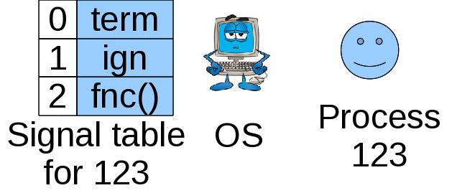
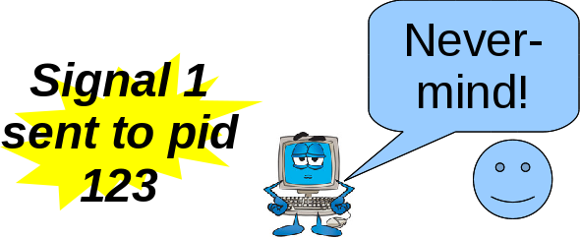
How OS handles signals (1)
Each process has its own signal table:
Some signals may be ignored or handled specially

Slide 13
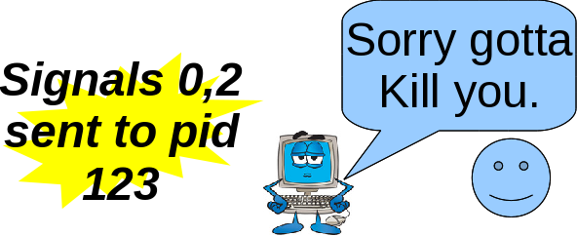
How OS handles signals (2)
Question: What happens if multiple signals of different number arrive around same time?
Answer: The lowest numbered signal takes precedence

Slide 14
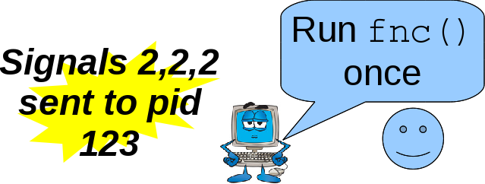
How OS handles signals (3)
Question: What happens if multiple signals of same number are pending?
Answer: Because they are not buffered, any called routine will only be called once and should be clever enough to handle any number of waiting cases.

Slide 15
A look at those actions
Some signals are so serious that the process must die!
  SIGILL: Illegal instruction (how could this happen?)
  SIGSEGV: Illegal memory reference (how could this happen?)
  Analogous to interrupt table's NMI (non-maskable interrupt) for very serious hardware problems like parity and checksum-like errors
Other signals are less serious
  SIGCHLD: A child has finished (Hey, wouldn't wait() or waitpid() always catch this for us?)

Slide 16
What does all this mean for me?
You the applications programmer get (some) control over your process' personal “interrupt table”
  Default action for this!
  Ignore that!
  Do it my way for the other!

Slide 17
Doing it!
#include <signal.h>
void handler (int signalNum)
{
// Handling code here
}
int main ()
{
signal(SIGINT,SIG_DFL); // Handle by default
signal(SIGINT,SIG_IGN); // Ignore SIGINT
signal(SIGINT,handler);
// Handle with handler()
// All the cool coders now use sigaction()
// (See appendix)
}

Slide 18
Your turn!
Write a program that
Prints “You can't stop me! Ngyeah-ngyeah, ngyeah-ngyeah!”
Pauses for 2 seconds
Goes back to 1.
Indefinitely, and that cannot be stopped by Ctrl-C.
(Question: Uh-oh, how can we stop it?)

Slide 19
Sending signals to processes (1)
Oh no! The program from the previous slide is still running!
  Ctrl-C can't stop it!
If we could send SIGKILL (9) we could stop it, but how?
$ kill -9 <processId>
  Question: How do we figure out the PID?
Forgive the bloodthirsty name, it should be called “sendSignal”

Slide 20
Sending signals to processes (2)
Process groups
  Each process belongs to a process group
  By default it's its parents group
  Can find out group pid_t getpgrp() in unistd.h.
  Can change group to one's own process id (or that of another process) int setpgid (pid_t pid, pid_t pgid)
  Can send signal to all processes in group by making process number negative
$ kill -9 -<processGroupId>

Slide 21
Back to the actions!
Some actions are un-ignorable and un-handle-able:
  QUESTION: Name 2 or 3 which you think are.
  QUESTION: Why?
Handlers should have form void someName (int sigNum)
  QUESTION: Why is the return type void?
  QUESTION: Why does it take the signal number as the sole parameter?

Slide 22
Your turn again!
Same as before, except this time each time the user does press Ctrl-C it randomly prints one of the following:
  “Ouch!”
  “Stop that!”
  “That hurts!”
  “Mercy!”
HINT: Use switch (rand() %4) { .. } to jump to cases 0 to 3 randomly

Slide 23
Sending signals to processes (3)
Application programs can signal each other too!
#include <sys/types.h>
#include <signal.h>
int kill (pid_t procToSignal, int sigToSend);
Again, forgive the bloodthirsty name, it should be called “sendSignal()”

Slide 24
Back to the shell
Our shell program always waited for the child process to finish.
Revise it so that it may have multiple children (ie. one of the children can run in the “background” along with the parent)
The background child process can finish at any time. (When it does SIGCHLD is sent to the parent, but by default this signal is ignored.)
Make sure you reap the child so it doesn't remain a zombie too long.

Slide 25
Back to the shell (2)
If multiple children finish around the same time will the different SIGCHLD signals be queued?
How can we revise our previous program to leave no zombies?
  HINT: wait() quits if there is nothing for to wait.

Slide 26

SIGALRM
#include <unistd.h>
unsigned int alarm(unsigned int secs);
If secs>0 then tells OS “Send SIGALRM to me secs seconds in the future”
If secs==0 then tells OS “Clear any alarms I may have set”
Either case returns number seconds until next (now cleared) alarm, or 0 if there were none.

Slide 27
Your turn!
Write a program that:
(1) Let's the user type in how many seconds they want to wait until an alarm goes off
(2) Continually prints “Tick-tock” until the alarm goes off. Then it prints “Ding-ding” and stops.
(3) If the user press Ctrl-C then it prints how many seconds are left and waits for the user to press Enter. Then it goes back to (2).

Slide 28
setjmp() and longjmp()
Old school C way of doing error recovery
int setjmp(jmp_buf j)
  Memorize both position in code (%eip) and position on stack (%esp) inside buffer j.
  First time it's called returns 0 (so you know this is the installation case).
void longjmp(jmp_buf j, int i)
  Uh-oh! We have a hard-to-recover-from error!
  Set %eax to i, jump back to “safe” state described in j.

Slide 29
Use
jmp_buf j; // Put in global context
int main()
{
if (setjmp(j) != 0)
{
// Handle error
}
attemptToDoSomethingErrorProne();
}
void attemptToDoSomethingErrorProne()
{
if (haveMessedUp == 1)
longjmp(j,1);
}

Slide 30
Abuse
/* Question: Will this behave properly? */
jmp_buf j; // Put in global context
int main()
{
foo();
bar();
}
void foo () void bar ()
{ {
if (setjmp(j) != 0) if (haveMessedUp==1)
{ longjmp(j,1);
// Handle error }
}
}

Slide 31
Bottom line on setjmp() and longjmp()
If you use them be sure you longjmp() to a function that is still on the stack.
Question: What modern error-trapping technique is in C++, Java, etc. that makes this C construct not necessary?

Slide 32
Next time: Threads!

Slide 33
Appendix: sigaction()
signal() is old school. Nowadays folks prefer:
int sigaction(int signum,
const struct sigaction *act,
struct sigaction *oldact);
It lets you:
See what action is currently being taken for a signal
Selectively block other signals while you're in a signal handler
Other (esoteric) stuff, too

Slide 34
sigaction() (2)
#include <signal.h>
int sigaction(int signum, const struct sigaction *act,struct sigaction *oldact);
Where:
struct sigaction
{
void (*sa_handler)(int); // Signal handler
void (*sa_sigaction)(int, siginfo_t*, void*);
// Funkier sig handler
sigset_t sa_mask; // Sigs to allow in handler
int sa_flags;//
void (*sa_restorer)(void);
};

Slide 35
sigaction() (3)
Ex: Install SIGINT handler if not already ignoring:
int main ()
{
struct sigaction newAction, oldAction;
//Define ctrlCHandler that wont block other sigs
newAction.sa_handler = ctrlCHandler;
sigemptyset (&newAction.sa_mask);
newAction.sa_flags = 0;
// See what is currently done for SIGINT
sigaction (SIGINT, NULL, &oldAction);
// Install new handler if not currently ignoring
if (oldAction.sa_handler != SIG_IGN)
sigaction (SIGINT, &newAction, NULL);
. . .

Slide 36
sigaction() (4)
Lots more detail!
See $ man sigaction

